Slide 1
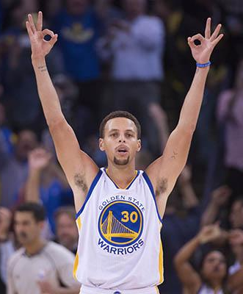
The Three-Point Revolution: Is It Changing Basketball for Better or Worse?
Charity Smith
MSDS 696: Data Science Practicum II
Regis University
Spring 2025

Slide 2
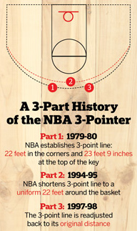

Problem Definition: Why Study the Three-Point Revolution?
"My 3-point shooting is something that I don't want to excel at because it takes away from all phases of my game.”
- Michael Jordan
The NBA has a 3-pointer problem
“On average, NBA teams are taking 37 3-pointers per game this season, which is two more than last season’s average — the largest year-to-year jump since 2019-20 if it holds. It’s an increase of 10 from just eight years ago and 15 more threes than teams were taking 10 years ago”

Slide 3


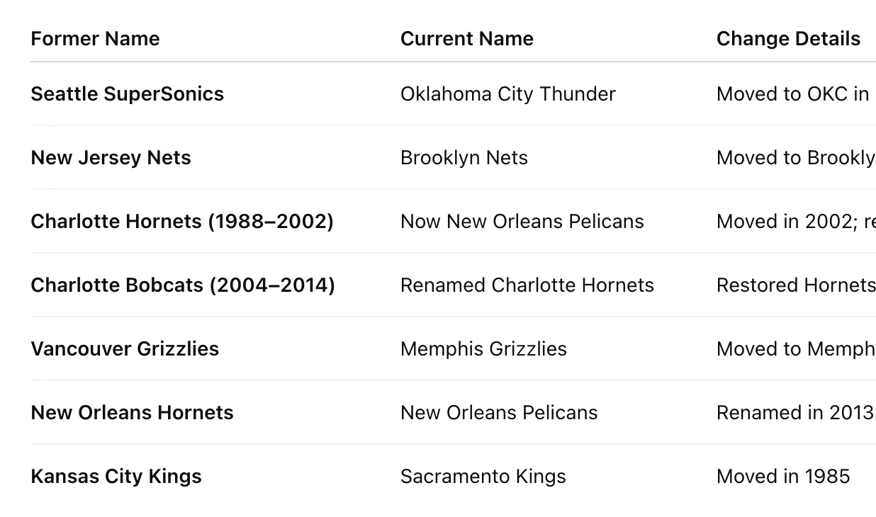
Data sources
📊 Team-level stats from Basketball Reference (3PA, 3P%, Win%, etc)
💬 Reddit posts and comments related to 3-point shooting (r/nba)
🧠 Combined quantitative data with fan sentiment different insights
🗓️ Covered seasons1980 through 2025

Slide 4
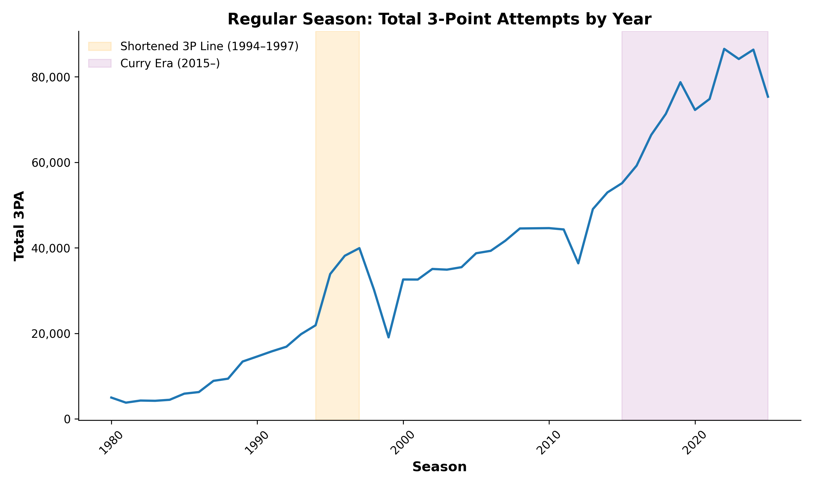
Shooting Trends
Three-point attempts per game have more than doubled since the early 2000s.
The real spike began around 2015, aligning with the rise of Steph Curry and analytics-driven offenses.
Three-pointers now make up over 40% of many teams’ total field goal attempts.

Slide 5
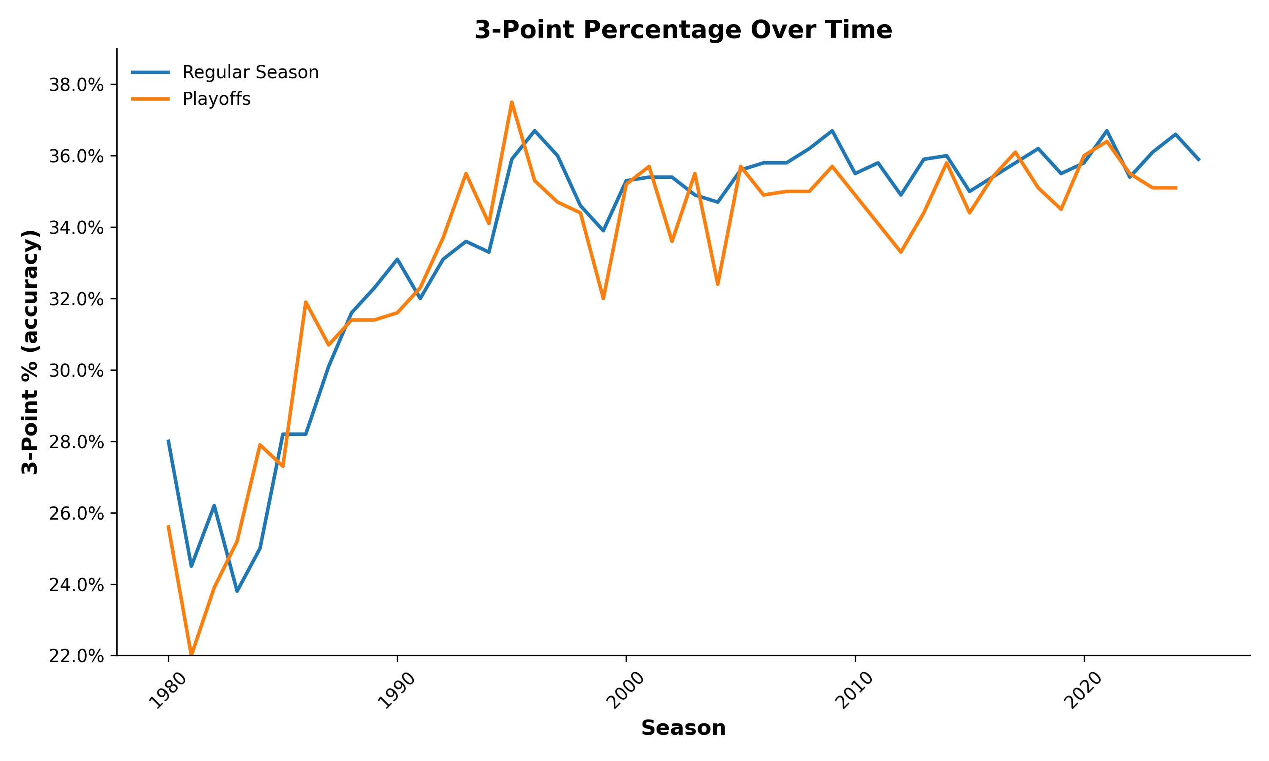
3-Point Percentage Over Time
Three-point percentage rose steadily from 1980 to 2010
Playoff and regular season trends are similar
Accuracy gains leveled off

Slide 6
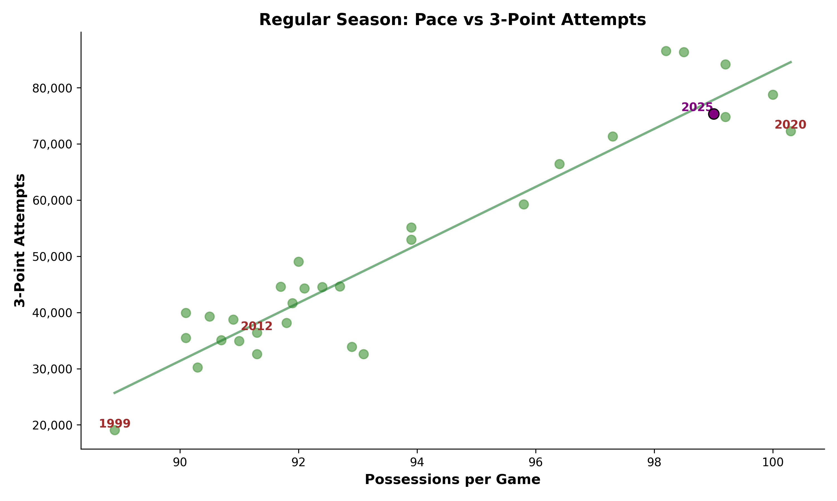
Pace vs. three-point attempts
Pace = possessions per game (game speed)
Higher pace leads to more 3-point attempts
1999, 2012 (lockouts) & 2020 (COVID) show lower volume
2025 stands out as a high-paced, high-volume season

Slide 7
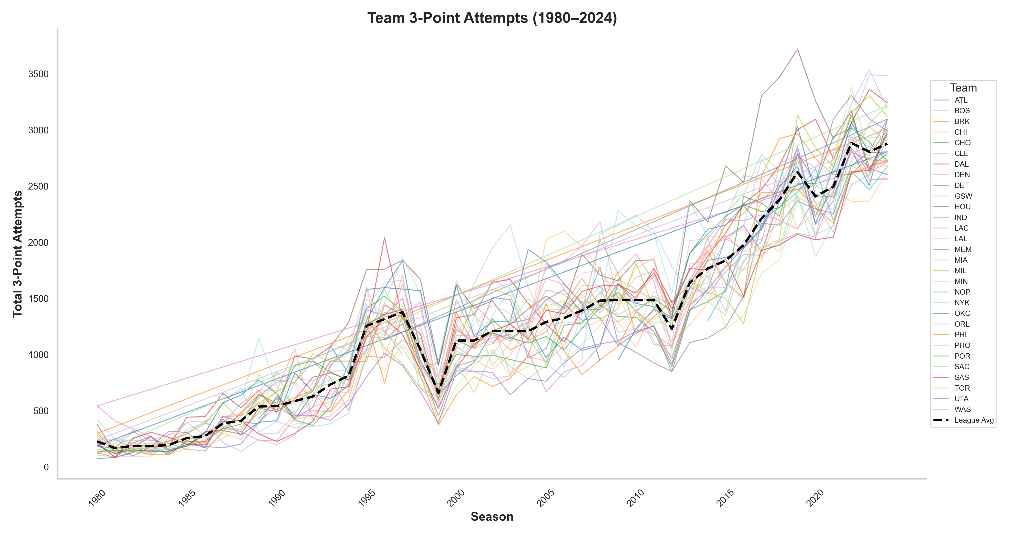
Team 3-Point Attempts by Season
League-wide growth exploded after 2015
Every team has ramped up three-point attempts
I built an interactive EDA to explore team-level trends

Slide 8
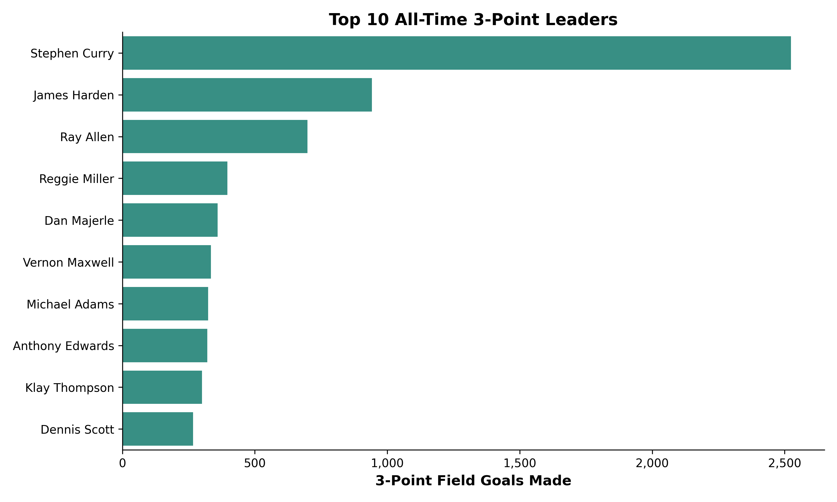
Top 10 All-Time 3-Point Leaders
Stephen Curry leads by a wide margin
Most players are from the modern era
Reflects the game's shift in strategy

Slide 9
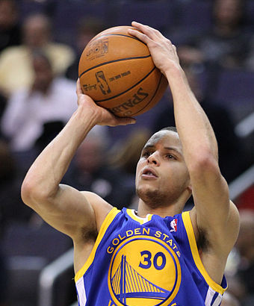
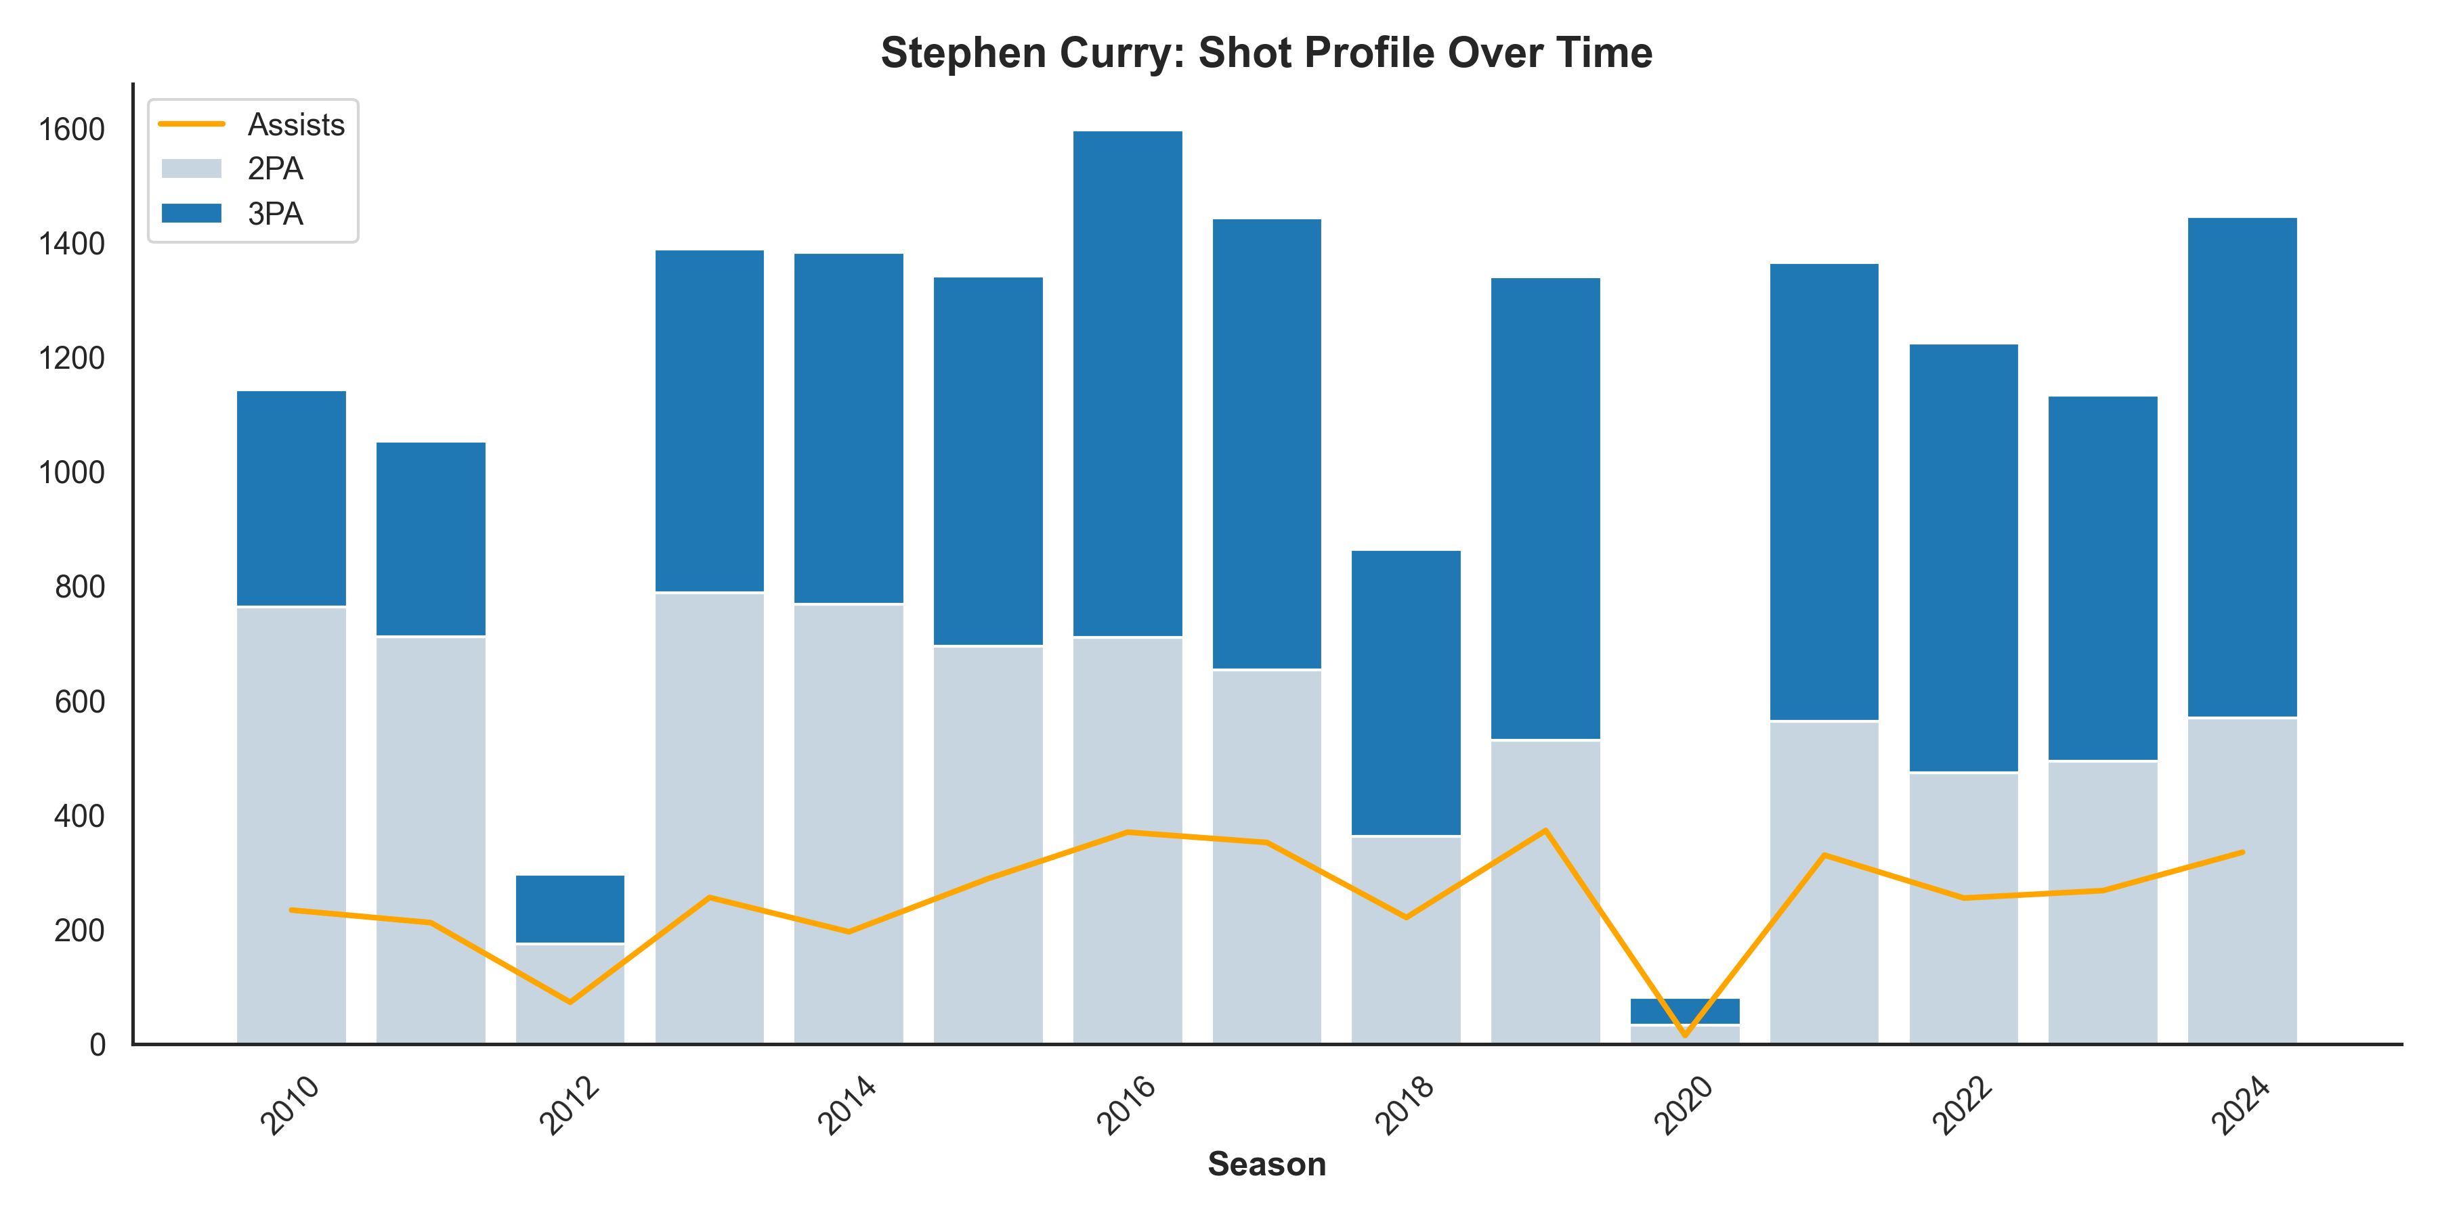
Player Spotlight: Steph Curry
This Photo by Unknown Author is licensed under CC BY-SA

Slide 10
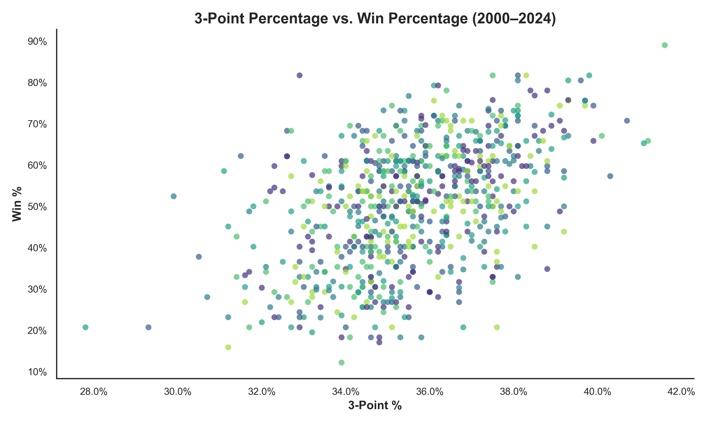
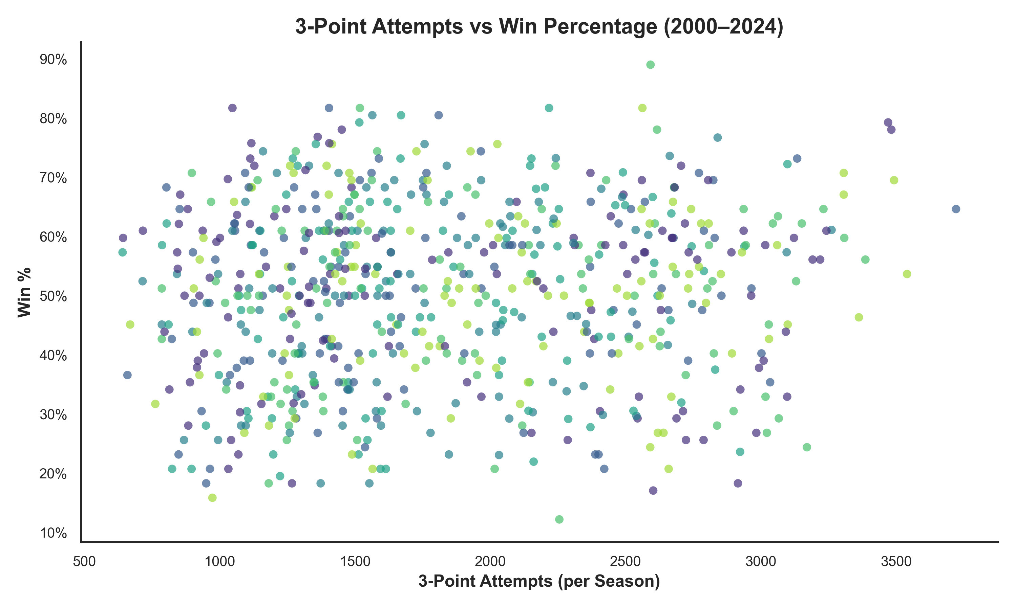
Does 3-Point Shooting Predict Winning?
Three-point % is a better predictor than three-points attempted
Efficiency > volume
Modern teams win by shooting threes well, not just often

Slide 11
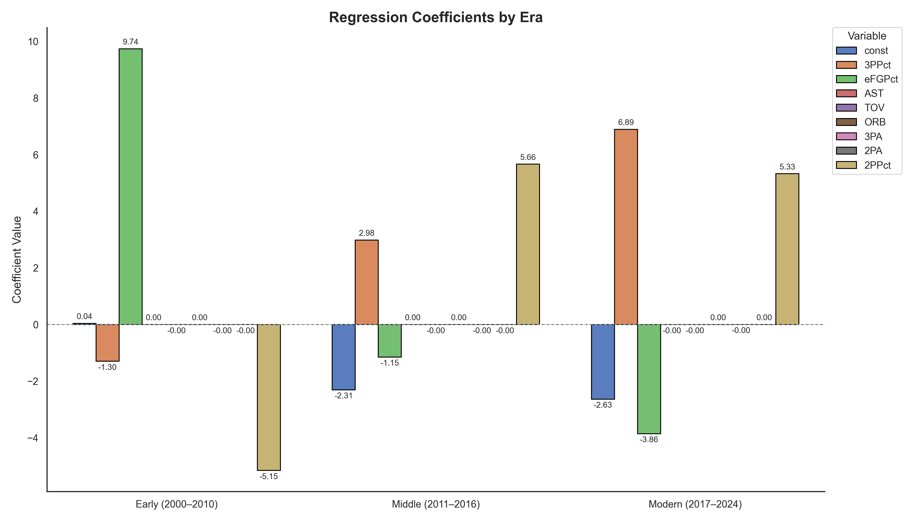
Predicting wins by era

Slide 12
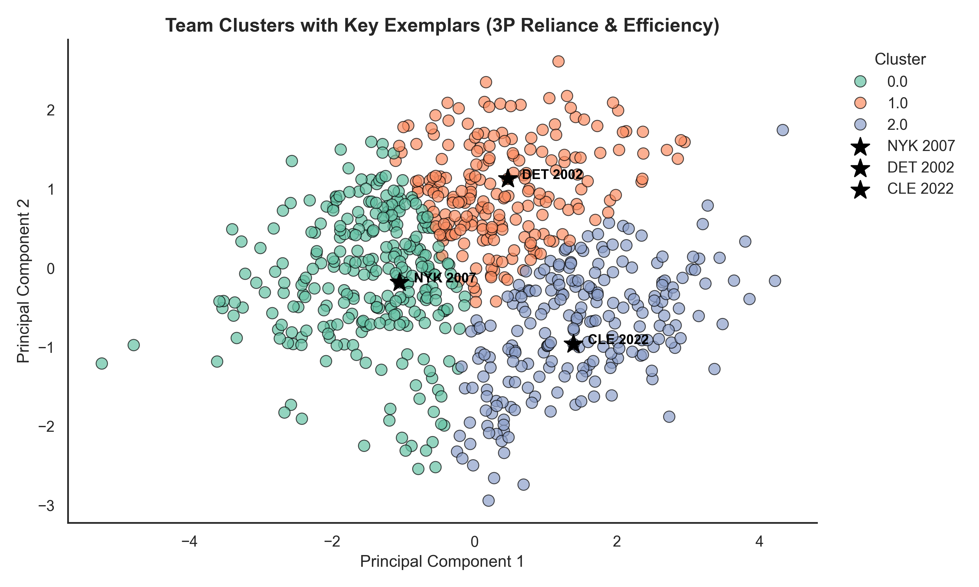
How Do Teams Cluster Based on three-pointer Style?
Used KMeans clustering with PCA to reduce dimensions
3 styles stood out:
Efficient & high win%
High volume, moderate win%
Low 3P use, low win%
I highlighted real teams from each cluster.

Slide 13
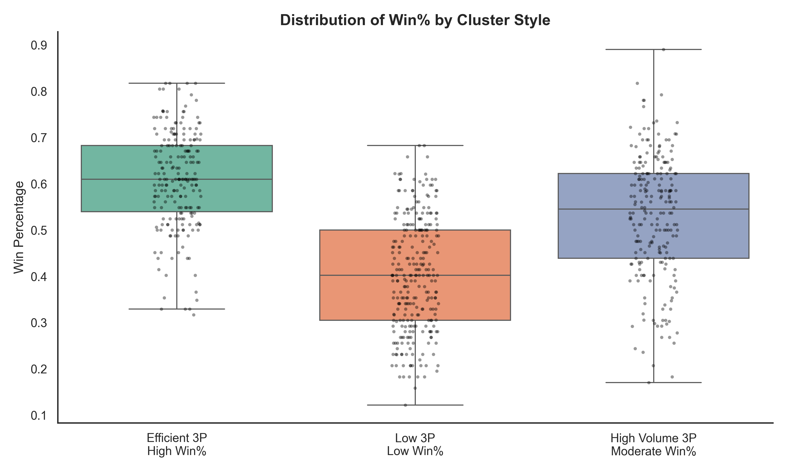
Which Style Wins the Most?
Efficient shooters (Cluster 0) have the highest win rates
High-volume, low-efficiency teams underperform
ANOVA confirms differences are statistically significant: (F = 9.23, p < 0.001)

Slide 14
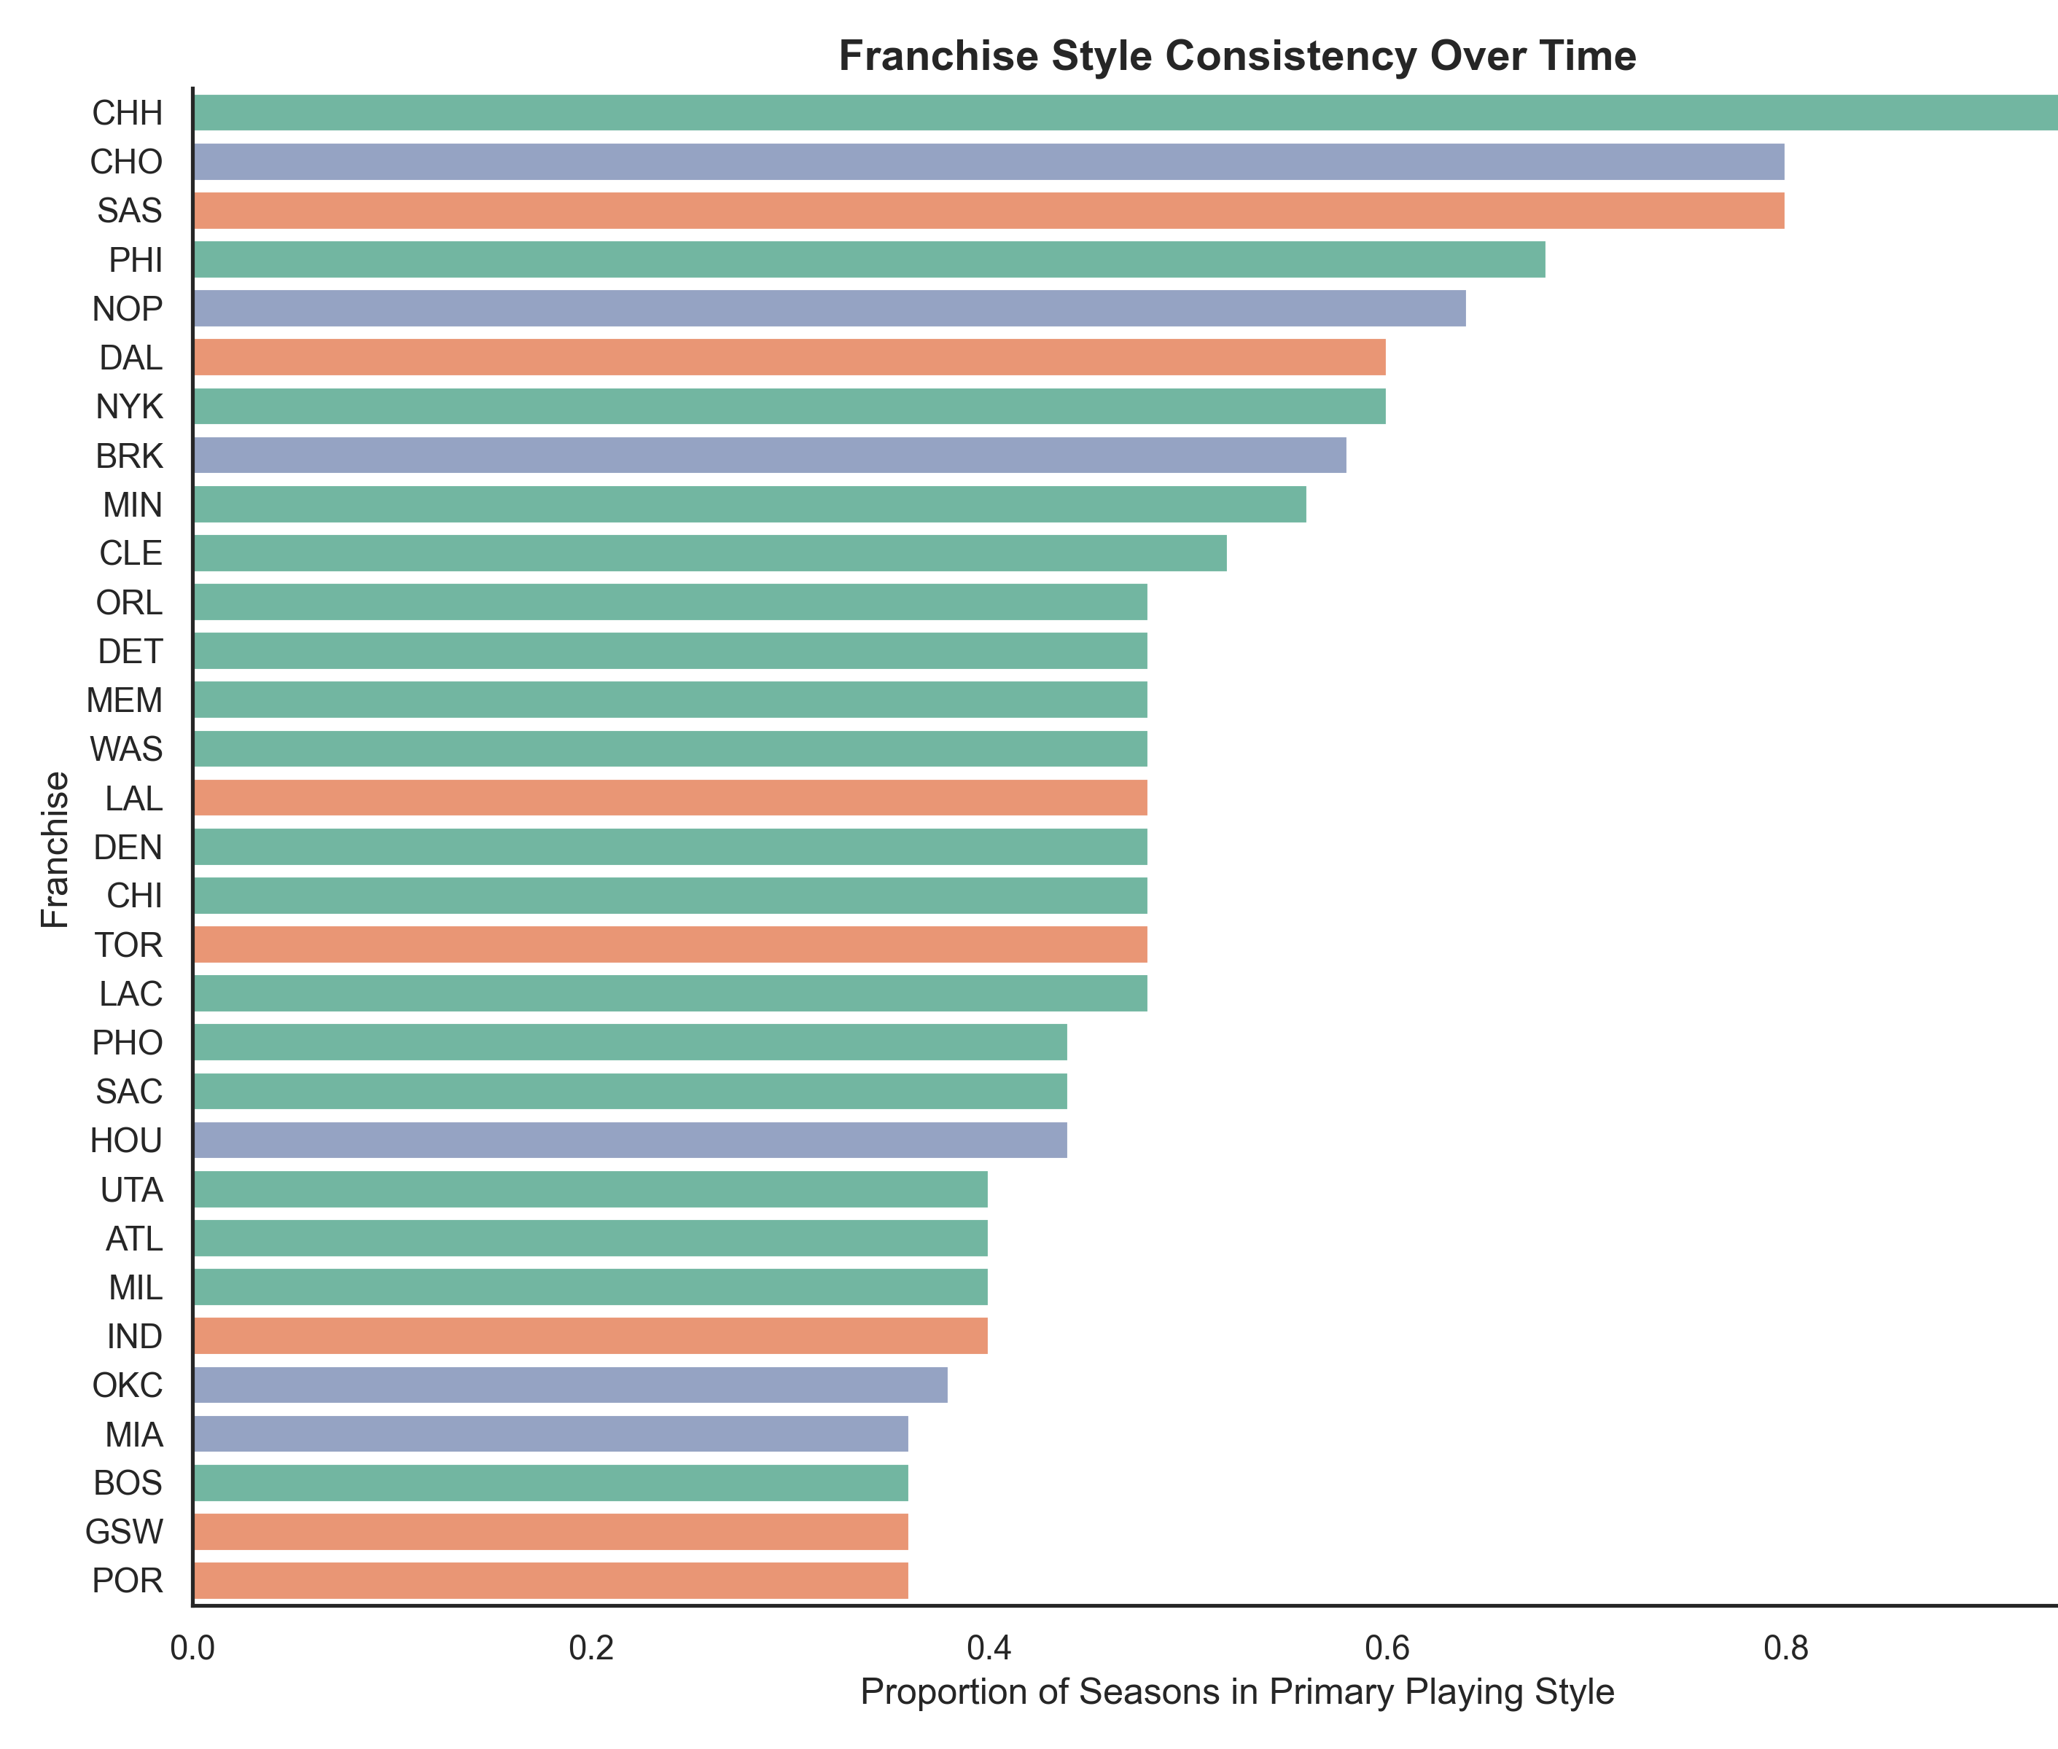
Do Teams Stick to a Style?
Some teams adapt their 3P style over time
Others maintain a steady approach for decades

Slide 15
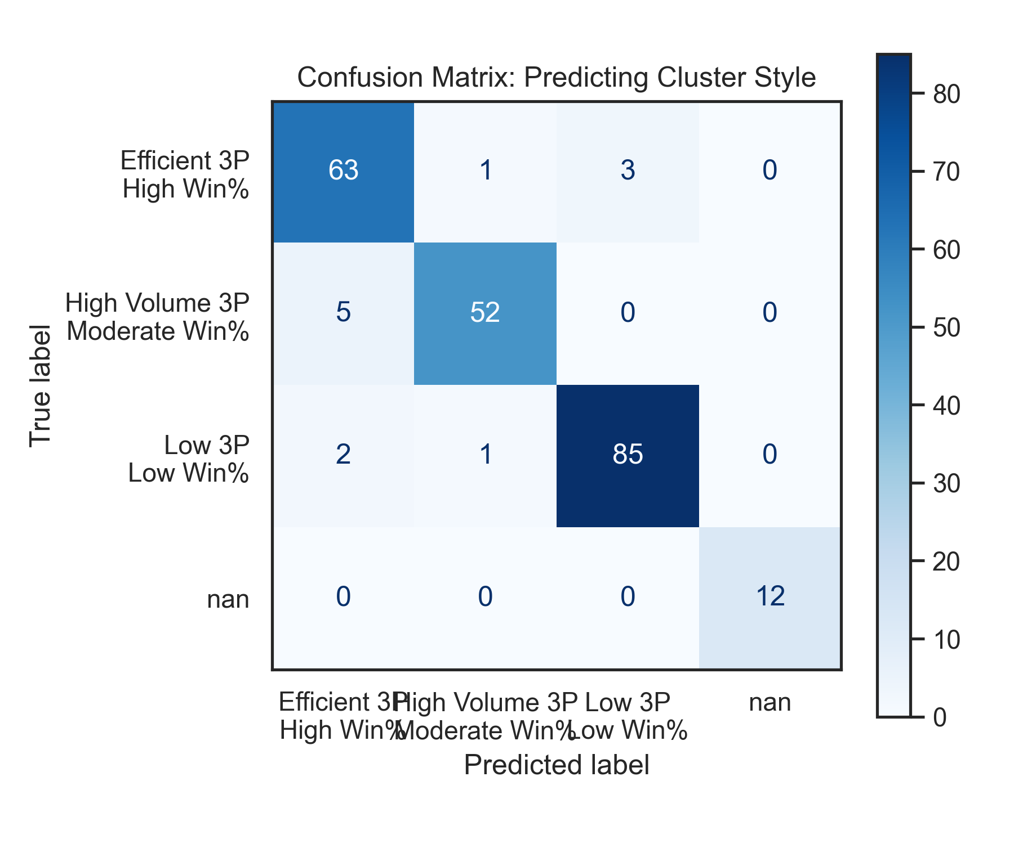
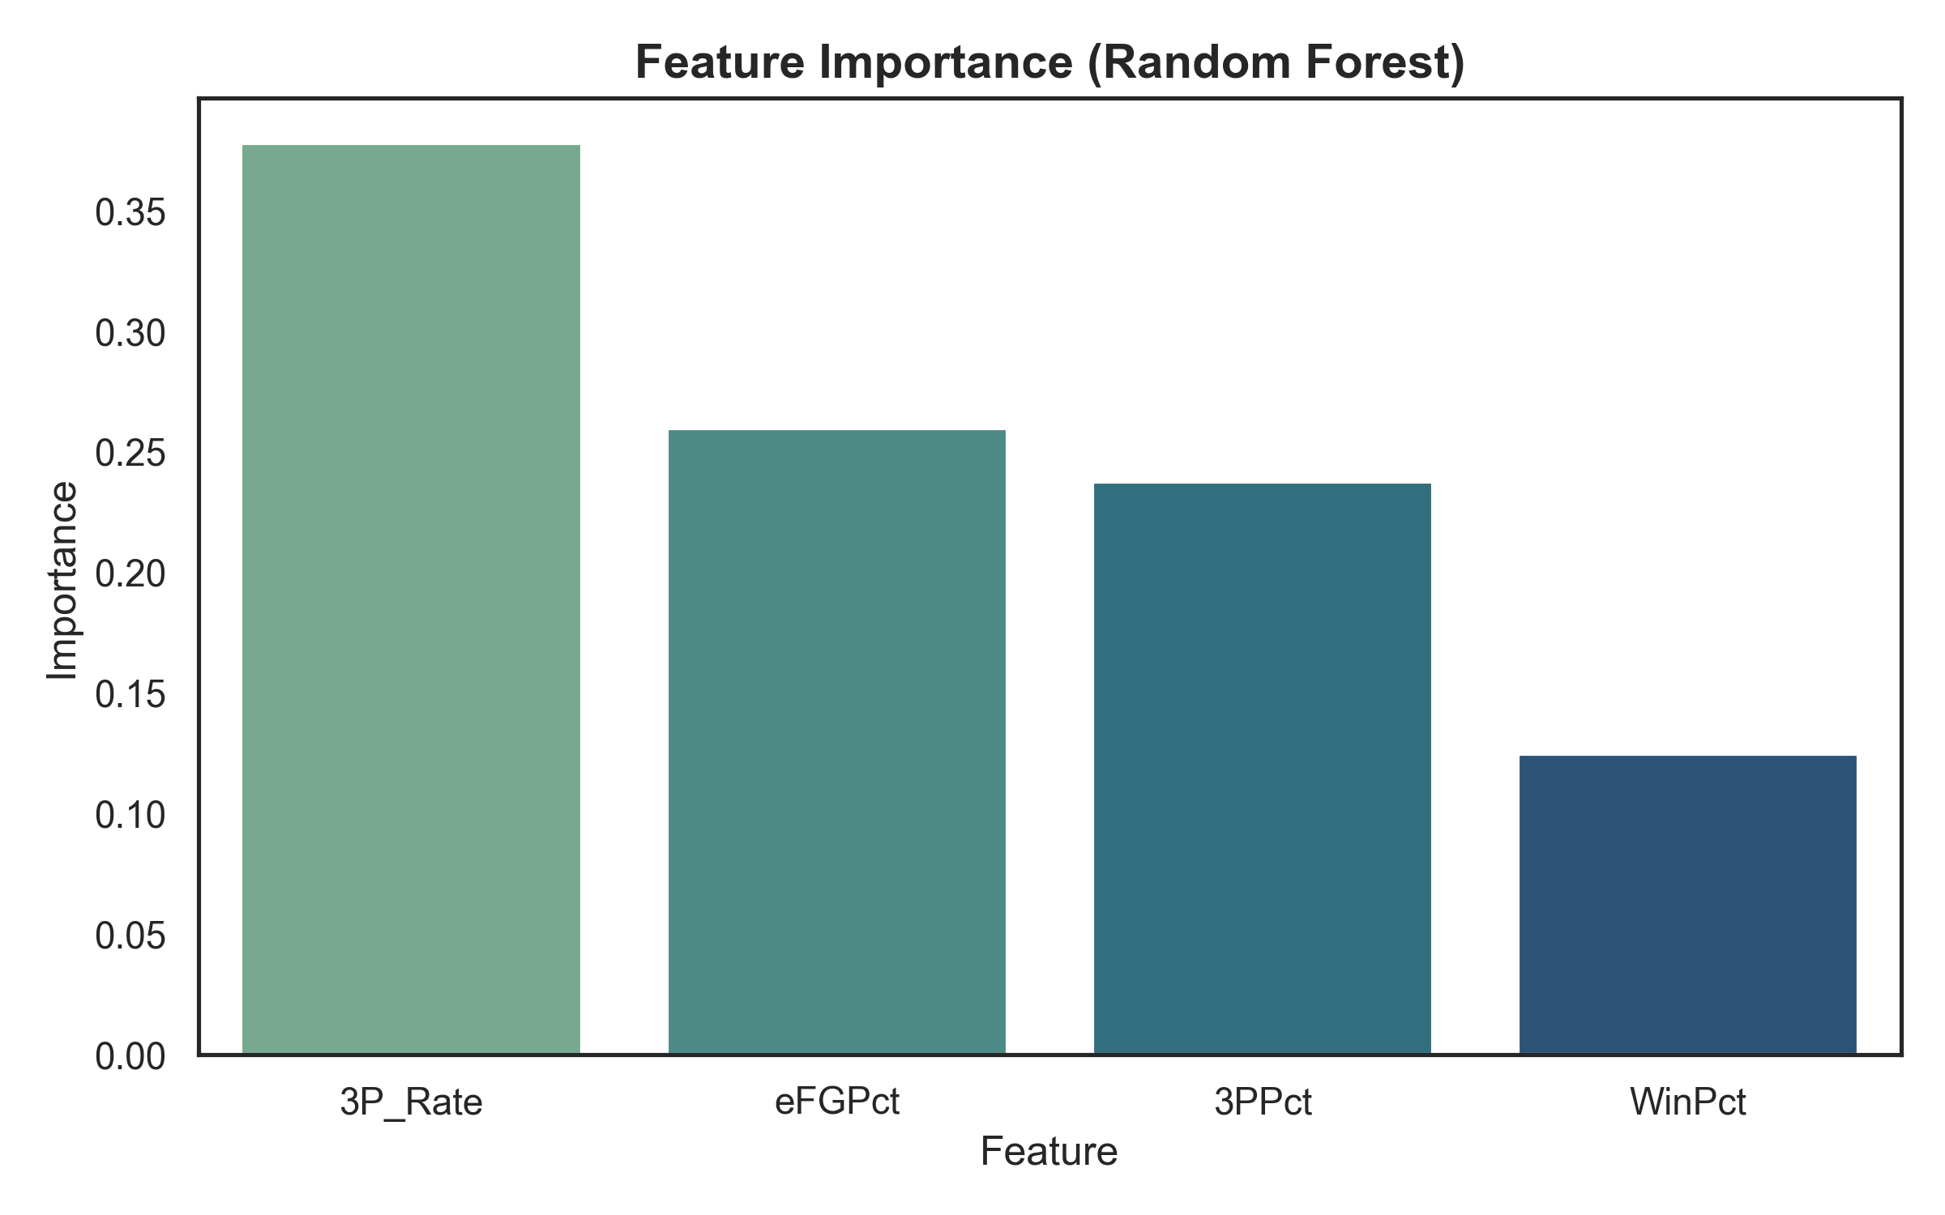
Feature Importance in Predicting Cluster Style
Model achieved ~87% accuracy

Slide 16
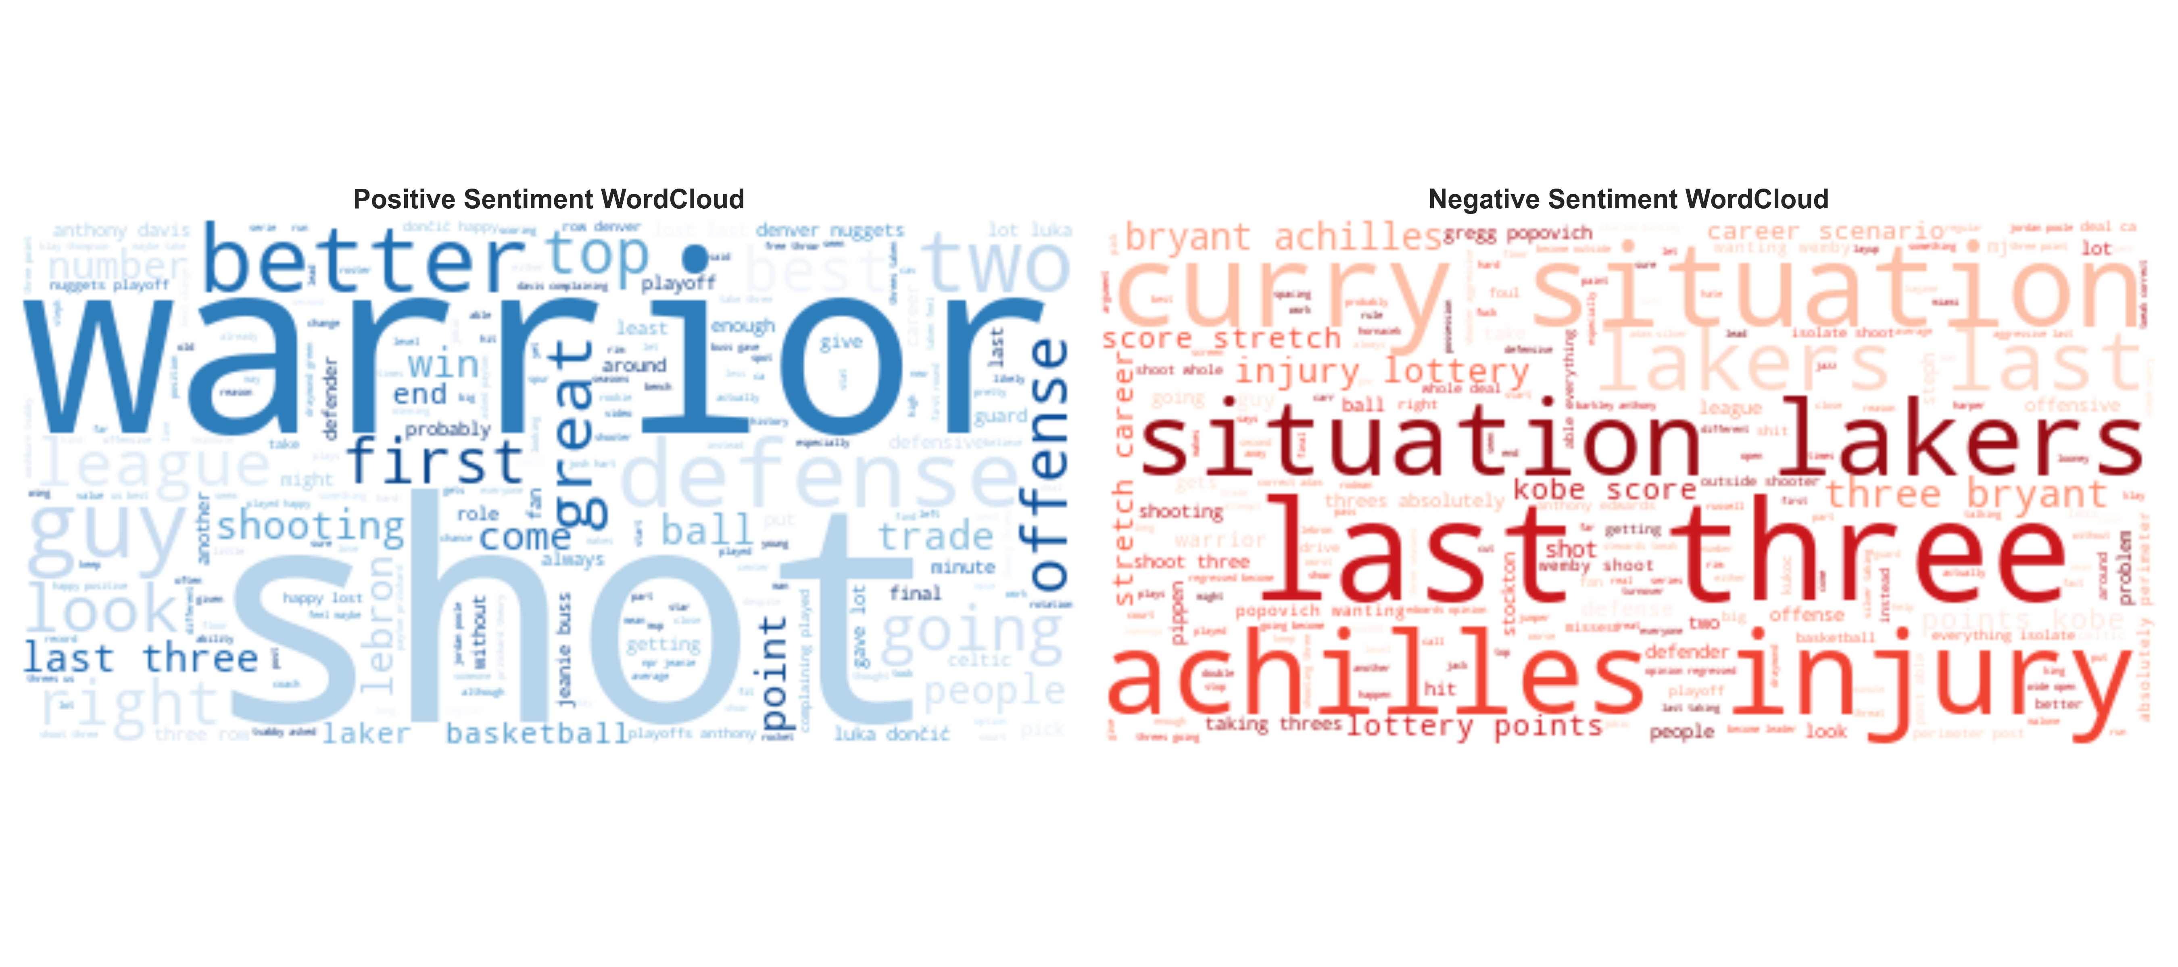
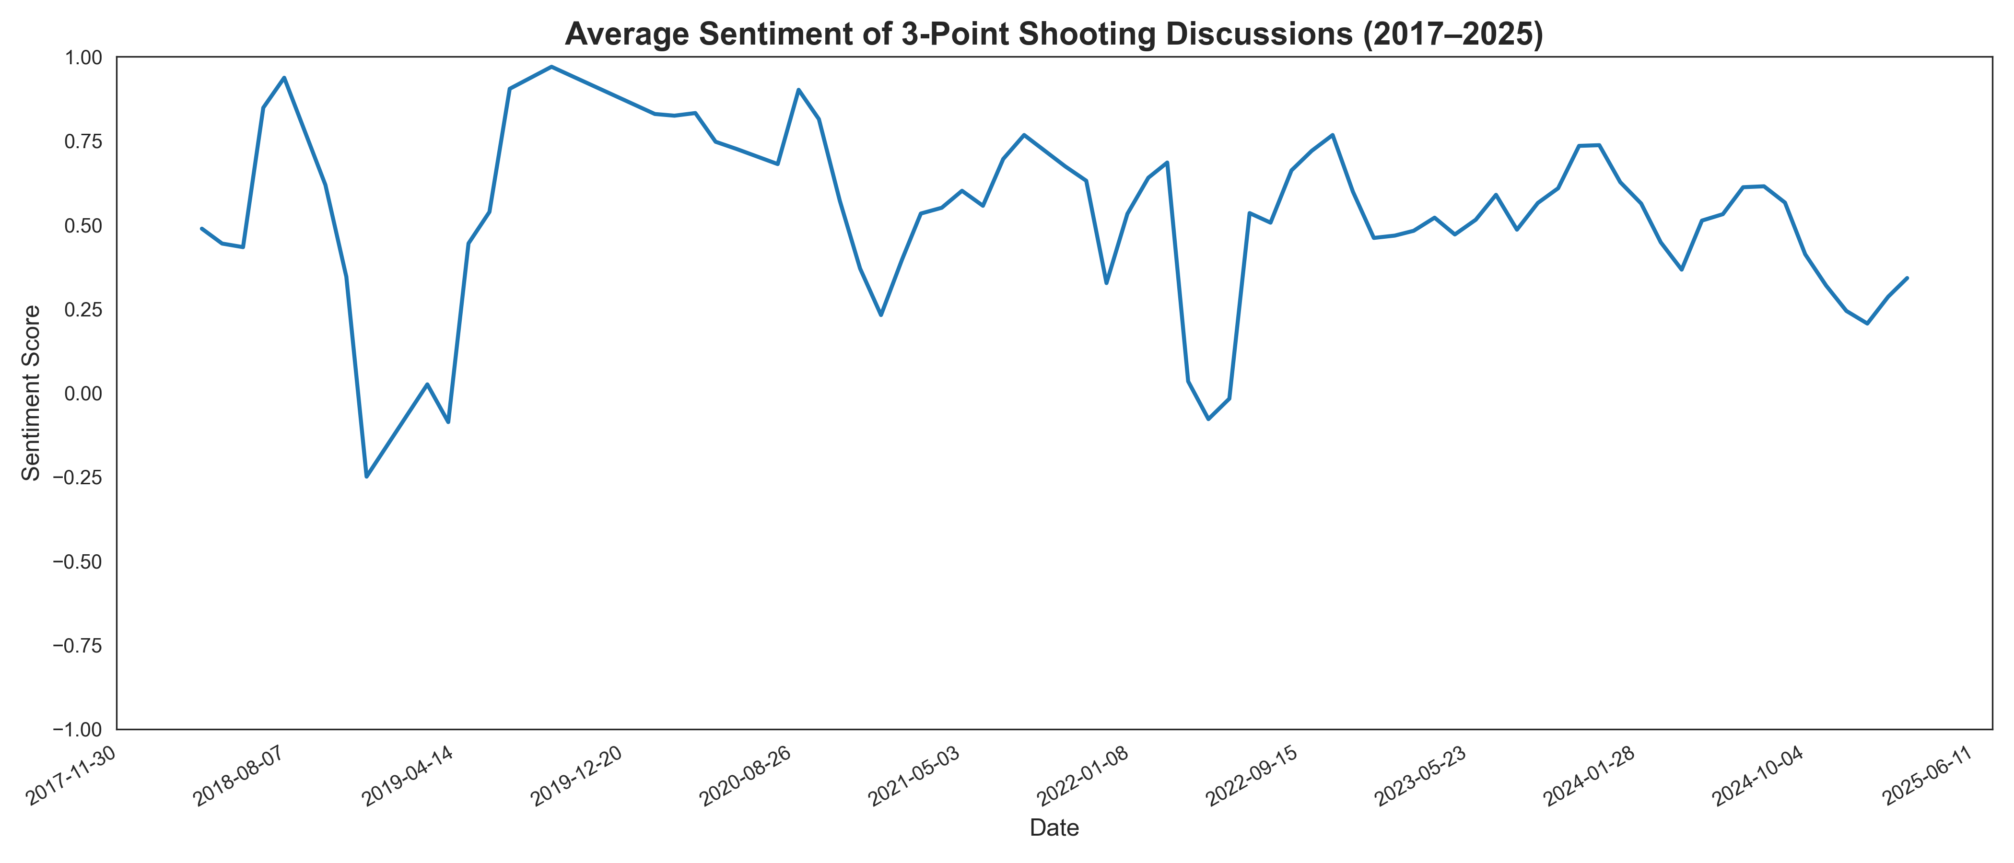
So… what do fans think?
Sentiment mostly stable
Slight positivity post-2015

Slide 17
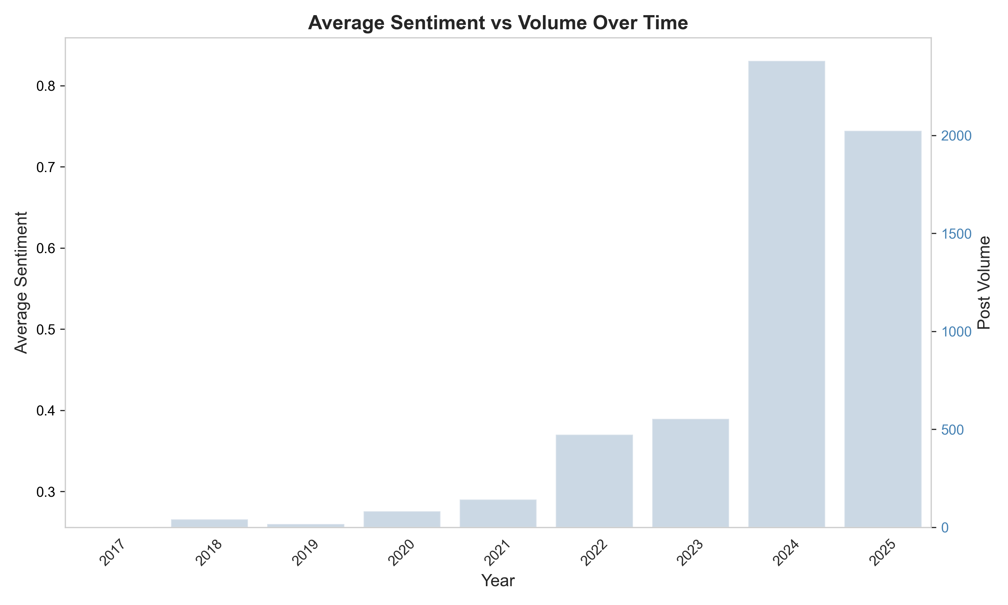
More Talk, Same Sentiment

Slide 18
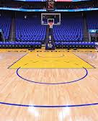
What the Data Tells Us?
Shooting efficiently matters more than just shooting a lot.
The most successful teams hit their threes at a high clip.
Playing style varies by franchise, and some evolve while others stick to tradition.
Despite all the changes and the articles and comments by NBA analysts, fan sentiment from Reddit data hasn't turned sour."

Slide 19
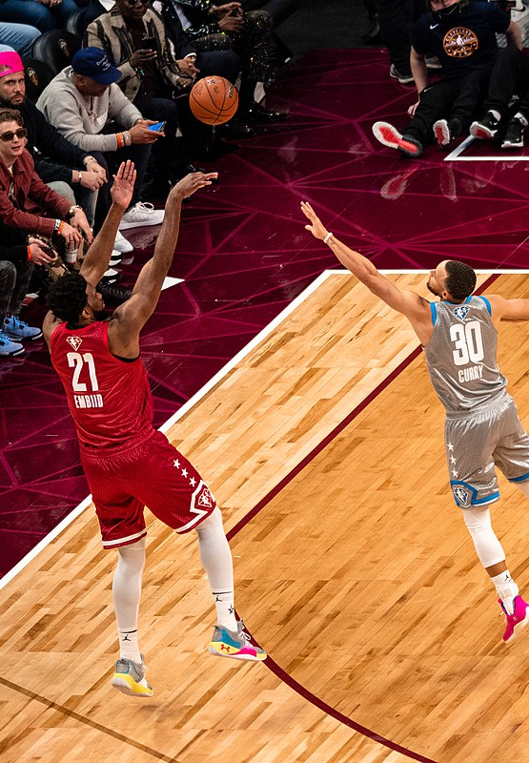
What next? Possible extensions
Cluster players instead of teams
Analyze playoff vs regular season strategy
Review attendance at games for teams in clusters
Look deeper at blowout games and competitiveness
Expand sentiment analysis to forums, interviews, and NBA focused chatter
Include more global fan reactions and media commentary

Slide 20


Slide 21
references
Basketball Reference. (n.d.). Basketball statistics and history. Retrieved May 4, 2025, from https://www.basketball-reference.com/
NBA.com. (n.d.). NBA stats. Retrieved May 4, 2025, from https://www.nba.com/stats
Leff, J. (2024, October 30). NBA teams are taking too many 3s and it’s becoming a problem. USA Today For The Win. https://ftw.usatoday.com/story/sports/nba/2024/10/30/nba-three-pointers-record-attempts-problem/75948024007/
Kota, D. (n.d.). Michael Jordan tried to warn the NBA about shooting too many 3-pointers. Sports Illustrated FanNation. https://www.si.com/fannation/backinthedaynba/michael-jordan-tried-to-warn-nba-about-shooting-too-many-3-pointers-01jfz2bsd70z#:~:text=Critics%20believe%20it%20has%20made,too%20many%20from%20the%20arc.

